Slide 1
Spring Security

Slide 2
What is Spring Security?
Spring Security is a security framework that secures J2EE-based enterprise applications, by providing powerful, customizable security features like authentication and authorization.
Spring security provides authentication and authorization to our application using simple servlet filters.

Slide 3
Core Concepts of Spring Security
Spring security works on the following core concepts
Authentication.
Authorization
Principal
Granted Authority
Security Context and SecurityContextHolder
UserDetails
UserDetailsService
AuthenticationManager

Slide 4
Advantages of Spring security
Here are some important advantages of Spring Security:
Servlet API integration.
Extensible support for both Authentication and Authorization.
Protection against attacks like session fixation, click jacking.
Spring MVC integration.
Ability to secure application against brute force attacks.
Portability.
Protection against CSRF attacks.
Java configuration support

Slide 5
Enable basic Spring security to J2EE applications
Add jar files/dependencies
Filter declaration to pom.xml
Java configuration by using SecurityConfiguration class

Slide 6
Few basic terms that are related to spring security
Principal: Currently logged in user.
Authentication: Confirming truth of credentials.
Authorisation: Defines access policy for the Principal.
GrantedAuthority: Permission granted to the principal.
AuthenticationManager: Controller in the authentication process. Authenticates user saved in memory via authenticate().

Slide 7
AuthenticationProvider: Interface that maps to a data store that stores your data.
Authentication Object: Object that is created upon authentication. It holds the login credentials. It is an internal spring security interface.
UserDetails: Data object that contains the user credentials but also the role of that user.
UserDetailsService: Collects the user credentials, authorities (roles) and build an UserDetails object.

Slide 8
Spring Security Modules
In Spring Security, the Security module comprises separate jar files based on its functionality.
spring-security-core.jar
spring-security-web.jar
spring-security-config.jar
LDAP
OAuth 2.0 Core
OAuth 2.0 Client
To add security to our Spring Boot application, we need to add the security starter dependency.

Slide 9
Difference between Authentication and Authorization ?
Authorization is the second stage of security whereas the first stage is Authentication.
Authentication answers — Who is this user? whereas, Authorization answers — Are they allowed to do this?
To reach authorization, you need authentication first. You have to make sure who the user is in order to decide what role the user is allowed to do or not allowed to do.
This is how authentication and authorization work in spring security.

Slide 10
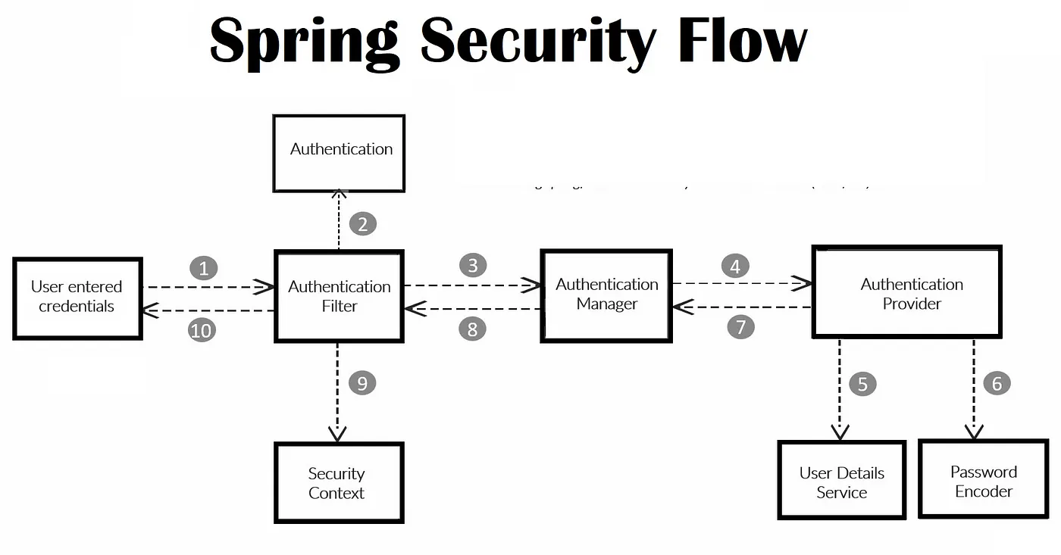
Spring Security Flow

Slide 11
Example for Spring Security Basic Authentication

Slide 12
Spring Security Filters Chain

Slide 13
About Spring Security Filters Chain
In a web application, we drive Spring security through the servlet filters.
Servlet filters works by intercepting the request before it reaches to the actual resource (e.g. Spring controller).

Slide 14
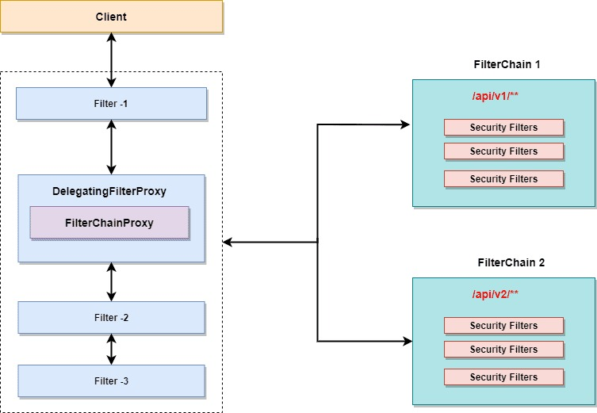
How filters work in a web application
Notes:
Client sends the request for a resource (MVC controller). Application container create filter chain to process incoming request.
Advertisements
Each HttpServletRequest pass through the filter chain based on the path of the request URI. (We can configure if we execute filter chain for all request or for specific request URI).
Filters perform the following logic on most of the web application.
Change the HttpServletRequest or HttpServletResponse before it reached to our Spring MVC controller.
Can stop the processing of the request and send a response to the client. (e.g. Servlet not allowing requests to specific URI’s).

Slide 15
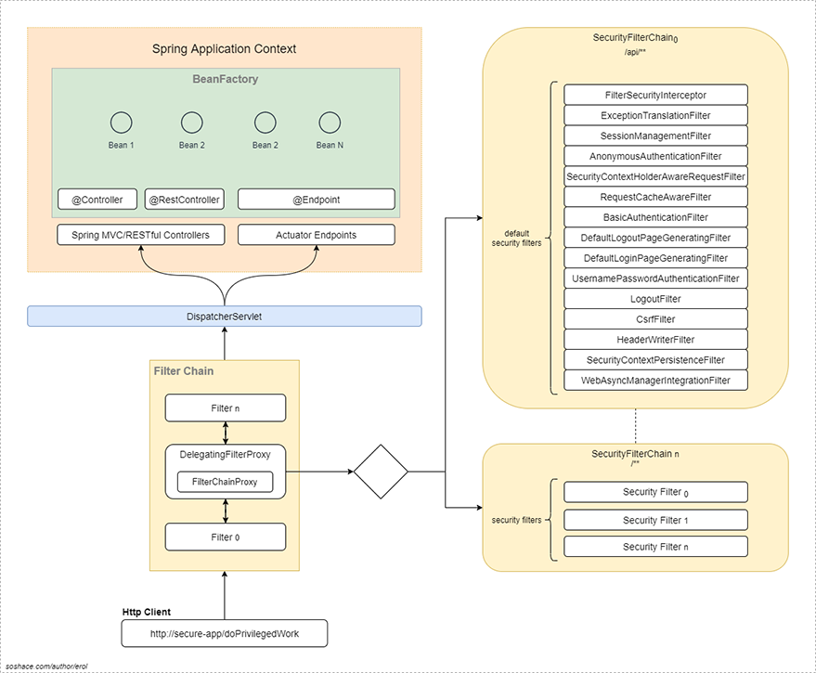

Slide 16
DelegatingFilterProxy
The DelegatingFilterProxy is a filter which works as a bridge between Servlet container’s life-cycle and Spring’s Application Context.
Servlet container does not have any information about the Spring’s application context, but spring security needs security filters to execute the task.
Since DelegatingFilterProxy is a servlet filter, the application server register it as a normal filter in the context.
The DelegatingFilterProxy as name suggests, delegates the work to the spring bean to start the security flow.

Slide 17
FilterChainProxy
This filter contains all the details about the different security filters available through the security filter chain. Let’s understand few important points about the FilterChainProxy:
The FilterChainProxy contains information about the different security filter chains and it delegates the task to the chain based on the URI’s mapping or using the RequestMatcher interface.
It’s not executed directly but started by the DelegatingFilterProxy filter

Slide 18
SecurityFilterChain
We can have multiple SecurityFilterChain configured in our application.
Filter chain for our REST API starting with /api/v2/**.
Filter chain for the internal communication /enterprise/**.
Security chain for other applications /**.
Spring security filter chain can contain multiple filters and registered with the FilterChainProxy.
Each security filter can be configured uniquely.
The FilterChainProxy determines which SecurityFilterChain will be invoked for an incoming request.

Slide 19
There are several benefits of this architecture :
It provides a centralized approach to start the process. There are no multiple entry points to the security stack.
Make it more easy to debug an application. We know where to start (FilterChainProxy is a prominent place to star).
Security is not an optional task, it’s a central point to start the process.
Clearing out the security context on logout is not optional and having one entry point make it easy to execute it.

Slide 20
Example using Spring Security Filters Chain

Slide 21
Spring Security Authentication
One of the core aim for any security framework is to verify the caller’s claim, the caller is who they claim to be. Authentication is the process to validate credentials and caller’s claim.

Slide 22
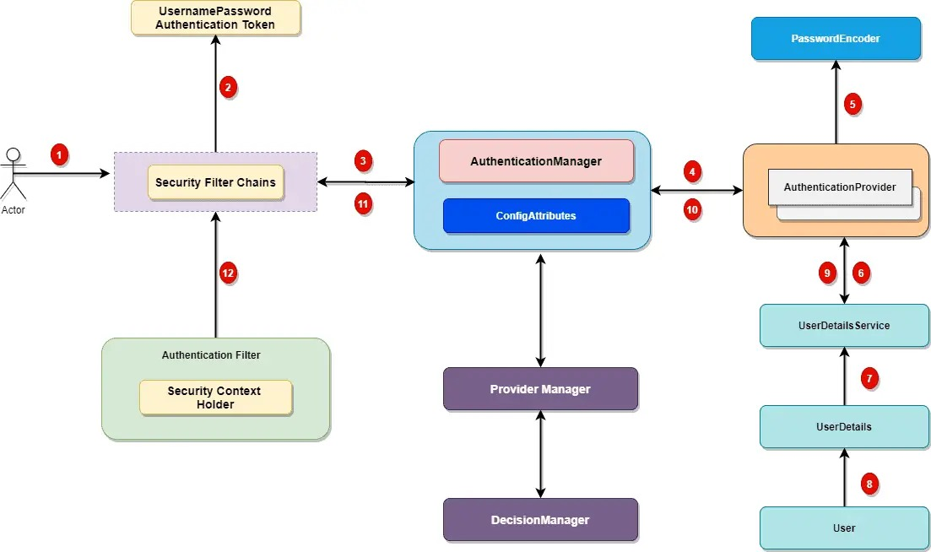
Spring Security Authentication Flow

Slide 23
Spring security comes with a set of security filters. Each request to the server is intercepted by these filters. These filters will process the request based on the logic and will pass or reject the incoming request.

Slide 24
Incoming HTTP Request
Each incoming request will go through a chain of filters for authentication and authorization process.
Each request will pass through the filters until it reaches relevant authentication filter.
Each request can go through a distinct set of security filters. We can configure filters by request patterns or even based on the request headers.
In above diagram, login request goes through the filter chains and reaches to the UsernamePasswordAuthenticationFilter.
Similarly, a basic authentication request goes through the chains of filters until it reaches BasicAuthenticationFilter.

Slide 25
Authentication Token Based on User Credentials
For the user login, once the authentication request reached the authentication filter, it will extract the username and password from the request payload.
Spring security will create an Authentication object based on the username and password

Slide 26
Authentication Manager
Authentication Manager is the core for the Spring security authentication process. AuthenticationManager is the API that defines how Spring Security’s Filters perform authentication.
Notes:
Before we move ahead, let’s cover important points for the AuthenticationManager.
Internally the AuthenticationProvider are responsible to perform the authentication process.
ProviderManager manager is the most commonly used implementation of AuthenticationProvider.
ProviderManager delegates the request to the list of AuthenticationProvider (We will discuss this in details during this series).

Slide 27
AuthenticationProviders
The AuthenticationProvider are responsible to process the request and perform a specific authentication. It provides a mechanism for getting the user details with which we can perform authentication

Slide 28
Custom Authentication Provider
For some enterprise applications, we may need a custom authentication provider. Implement the AuthenticationProvider interface to create a custom authentication provider for your application.

Slide 29
Spring Security UserDetailsService
Not all, but few authentication provider may need UserDetailsService to get the user details stored in the database by username (e.g. DaoAuthenticationProvider).
Most of the standard web application may use the UserDetailsService to get user information during login process.

Slide 30
Authentication and Authentication Exception
During the authentication process, if the user authentication is successful, we will send a fully initialized Authentication object back. For failed authentication, AuthenticationException will be thrown. A fully populated authentication object carries the following details:
User credentials.
List of granted authorities (for authorization).
Authentication flag.

Slide 31
Setting Authentication SecurityContext
The last step on the successful authentication is setting up the authentication object in the SecurityContext. It wraps the SecurityContext around the SecurityContextHolder.
The SecurityContextHolder is where Spring Security stores the details about authenticated users.
Spring security will not validate how the SecurityContextHolder is populated.
If it finds values in the SecurityContextHolder, it assumes that current user is an authenticated user.

Slide 32
Example on Spring Security Authentication

Slide 33
Spring Security Password Encoder
Spring Boot provides different password encoding implementation with the flexibility to choose a certain encoder based on our need.
Spring Security 5.0 introduces DelegatingPasswordEncoder as the new encoder to address following issues:
Encode password using latest storage recommendations.
Allowing for upgrading the encoding.

Slide 34
Example on Spring Security Authentication and Bcrypt Password encoder

Slide 35
How BCrypt Works
Before we move to the next section, Let’s answer one important question about the BCrypt algorithm – “If salt is random when encoding is called, how can BCrypt check if password submitted by user matches with the store one?“.
BCrypt generates the salt internally (we need not pass it).
It stores contacts with the cost and the cipher in a single field delimited by $.
When the user tries to login, it uses it on authentication.
To understand it better, let’s look at the encoded password:
$2a$10$96AvWDbaCiJlfzZ1fwZej.GSXFkAmPjqj12uSMa/RyB6zsIvsgNy.

Slide 36
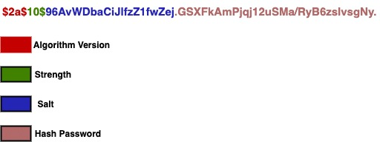
The first part represents the version ($2a, $2b, $2y) – in our case it is $2a$.
The second part is the strength – $10$ for our example.
The next 22 characters are the salt for the password (96AvWDbaCiJlfzZ1fwZej.).
Remaining section is the hashed password.
Here is the breakdown for better clarity:

Slide 37
Other PasswordEncoders
Pbkdf2PasswordEncoder
SCryptPasswordEncoder
Argon2PasswordEncoder

Slide 38
Example on Spring Security Register and Login

Slide 39
DaoAuthenticationProvider
For a standard login process, Spring security needs the customer information. Every project is unique in terms of the data model and how the customer data stored in the system.
Some application can use email id as unique and login id.
Other application design can let customer choose login id of their choice. For an intranet application, your employee id is your login id.
There should be a way to feed this information to the Spring security. In this article, we will look at the DaoAuthenticationProvider to authenticate customer using username and password.
You can also use the JDBC authentication. DaoAuthenticationProvider use the UserDetailsService to authenticate a username and password.

Slide 40
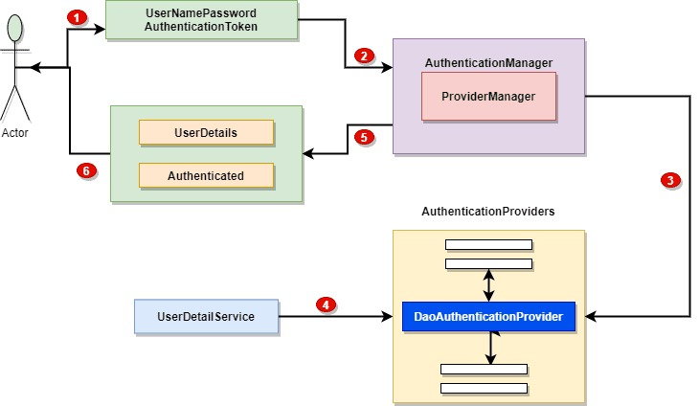
DaoAuthenticationProvider Workflow

Slide 41
We create an UsernamePasswordAuthenticationTokem from the supplied username and password.
We pass this token to the authentication manager.
The provider manager will delegate the authentication to the DaoAuthenticationProvider including the authentication token.
The DaoAuthenticationProvider use the custom UserDetailsService service to get the customer information from the database.
On successful authentication, the authentication object will contain the fully populated object including the authorities details.
The returned UsernamePasswordAuthenticationToken will be set on the SecurityContextHolder by the authentication Filter.

Slide 42
Example on Spring Security Login using Dao Authentication

Slide 43
Spring Security Login- Error Handling and Localization
With login, it’s very important to provide the correct error message information to the user.
For a simple application, we can work by providing some pre-defined error messages.
For enterprise applications, we have to give the error messages in the user preferred language. We don’t want to show English message to a German customer.

Slide 44
Spring security by default will show login error in case customer provides invalid username or password.
Spring security internally uses the Spring framework resource bundle feature to show customize error messages to the customer.

Slide 45
Example on Spring Security Error Handling and Localization

Slide 46
Spring Security Remember Me Authentication
Remember me is a feature for any web application where it remember the user between different visits and will automatically log you in if it finds the correct information.
You must have seen this while using Gmail or Amazon etc. where once you login, it will keep you login (if you select remember me option) and when you visit these sites next time, it will do an auto login for you. Spring security provides services to enable this feature.

Slide 47
Technically, this feature works with the help of browser cookies. Once you select the remember me option during your initial login, system will perform the following operations:
Create a remember me cookie with the help of username and password. (Cookie will have expiration period)
Hash the cookie and send it back to the browser.
In next visit, if the cookie is detected and if its valid, system will perform an auto login for you.

Slide 48
Spring security remember me authentication provides the support for the following 2 options :
Remember me authentication using cookie.
Token based remember me authentication

Slide 49
Example on Spring Security Login Using Remember me

Slide 50
Spring Security and Session Management
Spring security session management helps us to control the HTTP sessions.
Spring security use the following options to control the HTTP session functionalities:
SessionManagementFilter.
SessionAuthneticationStrategy

Slide 51
These 2 helps spring security to manage the following options in the security session:
Session Timeout detection and handling.
Concurrent sessions (how many sessions an authenticated user may have open concurrently).
Session-fixation – handle the session

Slide 52
When Is Session Created
Spring security provides different option to control the session creation. It provides us option to configure when the session will be created and how we can interact with the session. Here are the option available in the security which can help us configure and control the session creation.
SessionCreationPolicy.ALWAYS – Session will always be created (if it does not exist).
SessionCreationPolicy.NEVER – Spring Security will never create a HttpSession, but will use the HttpSession if it already exists (available through application server)
SessionCreationPolicy.IF_REQUIRED – Spring Security will only create a HttpSession if required (default configuration. If you don’t specify, Spring security will use this option)
SessionCreationPolicy.STATELESS – Spring Security will never create a HttpSession and it will never use it to get the SecurityContext.

Slide 53
For login based, application SessionCreationPolicy. IF_REQUIRED works for most cases and is also the default in Spring security.
For a typical web application.To change the session creation policy in Spring security, we can override the configure method by overriding the WebSecurityConfigurerAdapter.

Slide 54
Points to be noted
These configurations only control Spring security behavior but not your application. Your application might use different session creation configurations.
By default, Spring security will create session when required. It can use the session created by your application outside of Spring security context. (remember sessions are created by application server).
The STATELESS will ensure no session is created by Spring security, however that does not mean that your application will not create any session. This policy only applies to Spring security context. You might still see JSESIONID in your application, so don’t think that spring security configurations are not working

Slide 55
Example on Spring Security and Session Management

Slide 56
Example on Registration and Login using Spring Boot, Spring Security, Spring Data JPA, Hibernate, H2, JSP, and Bootstrap

Slide 57
What is JWT(JSON Web Token)?
JSON Web Token (JWT) is an open standard (RFC 7519) that defines a compact and self-contained way for securely transmitting information between parties as a JSON object.
This information can be verified and trusted because it is digitally signed. The client will need to authenticate with the server using the credentials only once.
During this time the server validates the credentials and returns the client a JSON Web Token(JWT).
For all future requests the client can authenticate itself to the server using this JSON Web Token(JWT) and so does not need to send the credentials like username and password.

Slide 58
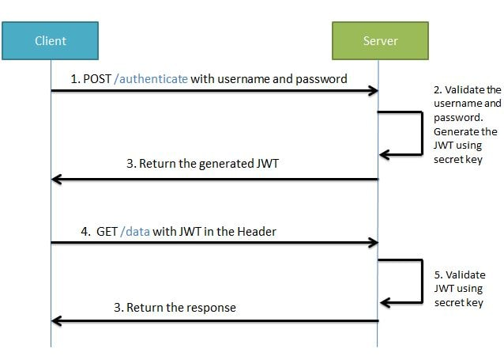
Workflow of how JWT is used?

Slide 59
During the first request the client sends a POST request with username and password.
Upon successful authentication the server generates the JWT sends this JWT to the client.
This JWT can contain a payload of data. On all subsequent requests the client sends this JWT token in the header.
Using this token the server authenticates the user. So we don't need the client to send the username and password to the server during each request for authentication, but only once after which the server issues a JWT to the client.
A JWT payload can contain things like user ID so that when the client again sends the JWT, you can be sure that it is issued by you, and you can see to whom it was issued.

Slide 60
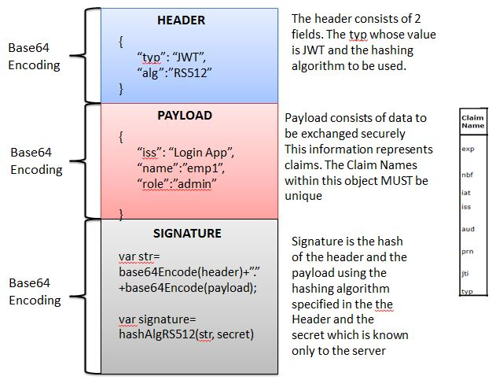
Structure of JWT
JWT has the following format -header.payload.signature

Slide 61
An important point to remember about JWT is that the information in the payload of the JWT is visible to everyone.
So, we should not pass any sensitive information like passwords in the payload.
We can encrypt the payload data if we want to make it more secure.
However, we can be sure that no one can tamper and change the payload information. If this is done the server will recognize it.

Slide 62
Example on Spring Boot, Spring Security, JWT

Slide 63
Introduction to OAuth
OAuth (Open Authorization) is a simple way to publish and interact with protected data.
It is an open standard for token-based authentication and authorization on the Internet.
It allows an end user's account information to be used by third-party services, such as Facebook, without exposing the user's password.

Slide 64
Five grants for acquiring an access token
The OAuth specification describes five grants for acquiring an access token:
Authorization code grant
Implicit grant
Resource owner credentials grant
Client credentials grant
Refresh token grant

Slide 65
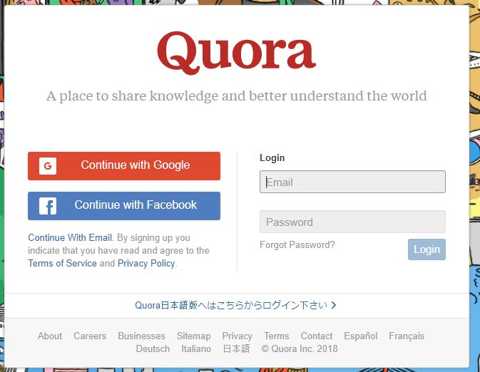
What actually is OAuth?
Consider the use case of Quora. Go to Quora.com.
If you are a new user you need to signup.
You can signup using google or facebook account. When doing so you are authorizing Google or Facebook to allow quora to access you profile info with Quora.
This authorizing is done using OAuth. Here you have in no way shared your credentials with Quora.

Slide 66
Actors in Quora
In the above example of Quora, we have 3 actors-
Resource Owner - This is the user who wants to sign up using Quora.
Client Application - This will be Quora
Resource Server - This will be Gmail or Facebook.
Authorization Server - The resource server hosts the protected user accounts, and the authorization server verifies the identity of the user then issues access tokens to the application.

Slide 67
How Oauth authorize the resource?
The resource owner will then using OAuth authorize the resource server to share data with the client application. The client application must first register with the authorization server associated with the resource server.
This is usually a one-time task. Once registered, the registration remains valid, unless the client application registration is revoked.
At registration the client application is assigned a client ID and a client secret (password) by the authorization server.
The client ID and secret is unique to the client application on that authorization server. For example if we click on Continue with Google, we get the following screen. Here we can see Quora client id.

Slide 68
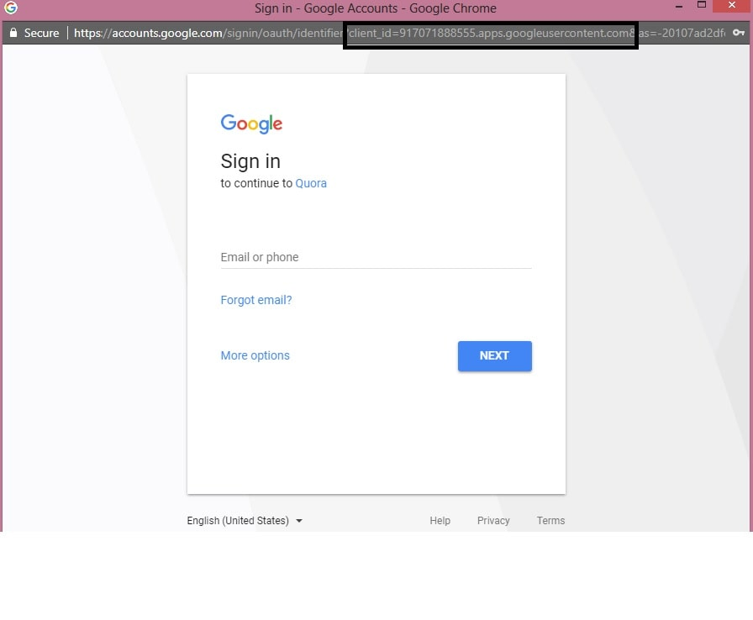

Slide 69
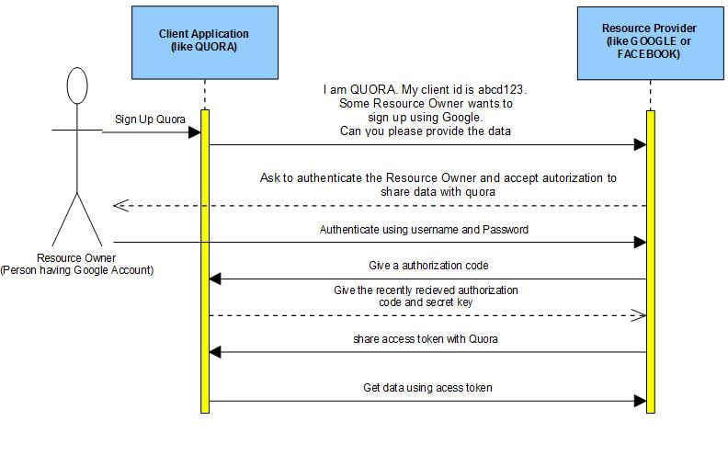
Quora got this client id and a secret key when it registered with Google.
The actual authorization process that takes place between Quora and Google using OAuth is as in diagram

Slide 70
The flow we will be implementing is as follows :
The Resource Owner will ask the Client Application to get some data from the Resource Server.
The Resource Server asks the Resource Owner to authenticate itself and as for authorization to share data.
After successful authentication the Resource Server shares an authorization code with the client application

Slide 71
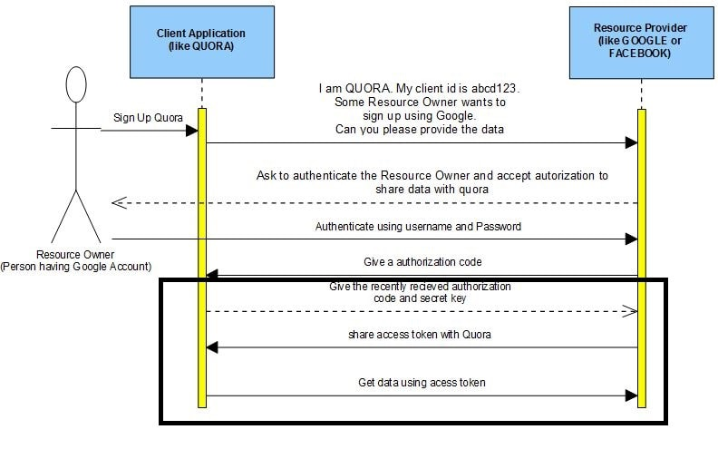
Fetching and using the Access Token
The Client Application using the Authorization code and Secret key ask for the Access Token from the Resource Server.
The Resource Server shares the Access Token with the Client Application.
Using the shared Access Token the Client Application can now get the required JSON data from the Resource Server

Slide 72
Example on Spring Security and Oauth

Slide 73
Spring Cloud

Slide 74
What is Spring Cloud?
Spring Cloud is considered a framework used for developing strong cloud applications. It is also used for building Microservices applications. It is used for developing configuration management, cluster state, a control bus, intelligent routing, etc.

Slide 75
Spring Cloud Features
Service Discovery and intelligent routing
Service to Service calls
Leadership Election
Load balancing
Distributed configuration
Global Locks
Distributed Messaging

Slide 76
Components of Spring Cloud
Configuration
API Gateway
Tracing
CI Testing and Pipeline
Service Discovery
Client-side discovery
Server-side Discovery
Circuit Breakers
Routing and Messaging

Slide 77
Advantages of Spring Cloud
It allows one service to communicate with another service.
It is used to develop applications based on the cloud.
Its architecture is designed according to the microservice.
It adopts a spring boot model.

Slide 78
Primary Projects of Spring Cloud
Spring Cloud Netflix
Spring Cloud Data Flow
Spring Cloud AWS
Spring Cloud DevOps
Etc.,

Slide 79
Example on Spring cloud and microservices example

Slide 80
Thank You

